Slide 1
Police Investigation Management System
Shreya Agarwal, Elizabeth Lagani, Jack Padoleski, Say Lay Paw, Conner Smith, and Liam Sweeney
Faculty Advisor: Dr. Sangwon Yoon
Watson Institute for Systems Excellence
State University of New York at Binghamton
April 4th, 2025

Slide 2
Agenda
Progress Updates
Key Updates
Next Steps

Slide 3
Progress Update
Tasks | Status | Completion% | Target Completion Date
User Login & Authentication | Completed | 100%
Create Case & Leads | Completed | 100%
Lead Log | Completed | 100%
Lead Returns | Completed | 100%
Lead Hierarchy | Completed | 100%
Report Generation | In Progress | 90% | 07/04/25
Leads Desk | In Progress | 90% | 07/04/25
Notification | In Progress | 90% | 07/04/25
Search Leads | In Progress | 20% | 10/04/25
Filter & Sort | In Progress | 20% | 10/04/25
View Timeline Entries | In Progress | 20% | 10/04/25
Admin Management | In Progress | 50% | 15/04/25
View Chain of Custody | Not Started | 0% | 15/04/25
Cloud Migration | Not Started | 0% | 10/05/25

Slide 4
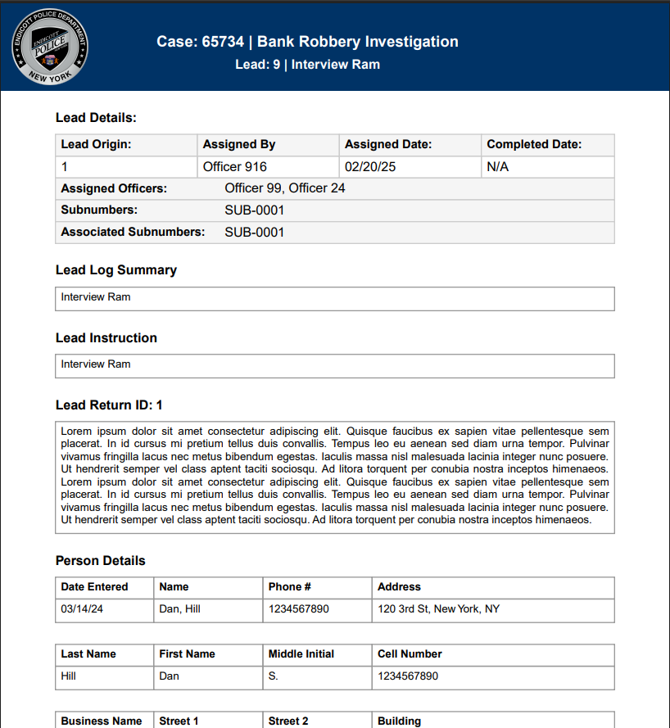
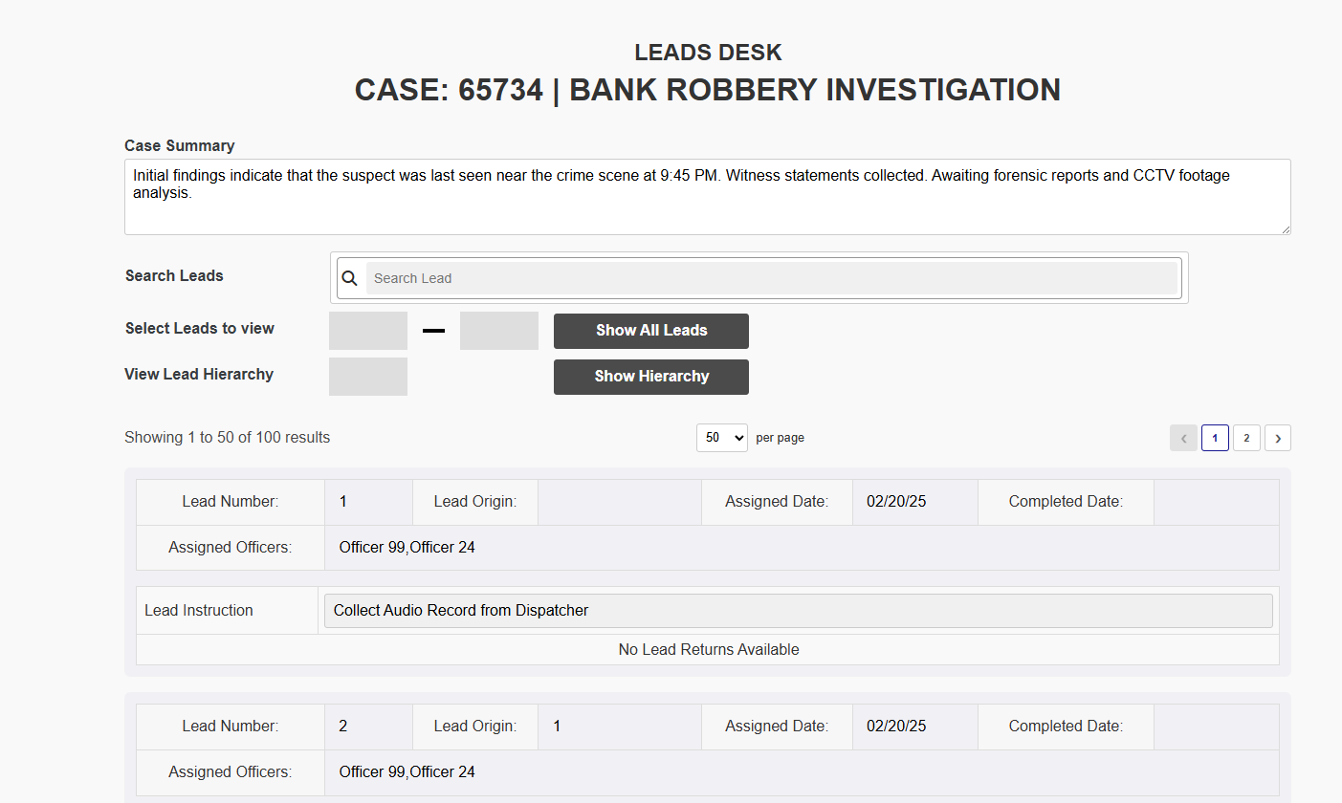
Key Updates
The report, as well as the Leads Desk functionality, has been updated

Slide 5
Next Steps
Continue developing the pending functionalities and cloud migration

Slide 6


